Slide 1
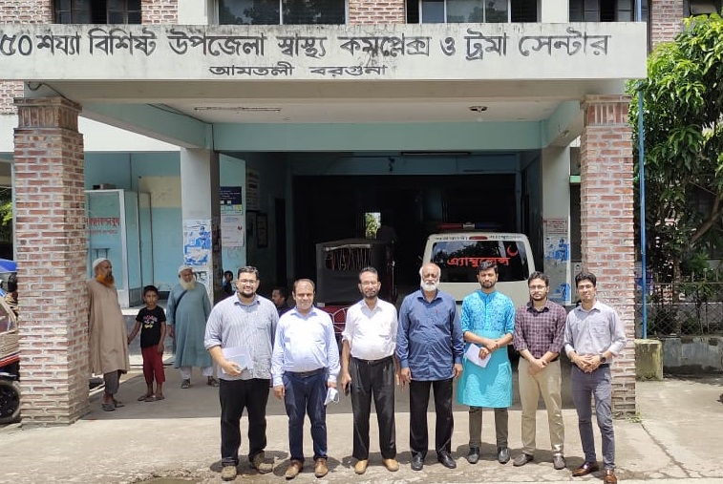
50 BEDDED UPAZILA HEALTH COMPLEX
Amtali, Barguna.

Slide 2
A Sub-district level Hospital with a Vision
Maximum utilization of Govt.
resources with
honesty and sincerity
Integrated approach of
Administration, Community
Leaders & Health
Management
Providing Effective and
prompt services
through improved
management system

Slide 3
Health Profile of Amtali Upazila- 2022
1. Total population : 270802
2. Total Fertile Couples : 57254
3. Total Pregnant : 11064
4. Total Delivery : 4342*
5. Total Live birth : 4310*
6. Total death : 932*
7. Total Maternal death : 02*
8. Health Man power
a. Doctor : 19 ( 11 + 8)
b. Nurse + Midwife : 33+6
c. HA : 36
d. SBA : 8 HA
9. Health Institutions
a. Health Complex : 01
b. H & FWC : 9 (RD- 2 + FWC– 7 )
c. Community clinic : 32
d. 10 Bed Hospital : 01
*Data to be corrected

Slide 4
Health Profile of Amtali Upazila- 2022 (Contd)
10. Mother Taken-ANC : 14.5% ( 1st Visit)
11. Hospital Delivery Rate : 2.5% (105)
12. No. of Hospital bed : 50
13. Bed Occupancy Rate : 96.96%
14. EPI Coverage Rate : [To be filled]
15. CPR : [To be filled]
16. TFR : [To be filled]
17. Maternal Mortality Ratio : 18.07/ 100000 live Birth*
18. Neonatal Mortality Rate : 8.53 / 1000 live birth*
19. Infant Mortality Rate : 8.99/1000 live birth*
20. Under-5 Mortality Rate : 11.98/1000 live birth*
*Data to be corrected

Slide 5
Background History of
Amtali Upazilla Health Complex, Barguna.
The health complex started as 31 bedded UHC in 1978*.
The health complex was upgraded to 50 bedded hospital in 2008*.
The health complex was awarded Health Minister’s Award in 2017*.
Digital X-Ray started in 2018*.
Trauma Center started in 2018*.
Vision Center started in 2019*.
Ultrasonography started in 2020*.
SSK Program started in July, 2022.
*Data to be corrected

Slide 6
Upazila Health Complex
Amtali , Barguna.
UHC
Bed Occupancy Rate from 2019 to 2021

Slide 7
Emergency & Out Door, Indoor Service 2019 to 2021
Upazila Health Complex
Amtali , Barguna.

Slide 8
Upazila Health Complex
Amtali , Barguna.
EOC Activities : 2019- 2021 (Hospital Delivery )

Slide 9
Comparative data of revenue income (in Taka) from 2019 to 2021
Upazila Health Complex
Amtali , Barguna.

Slide 10
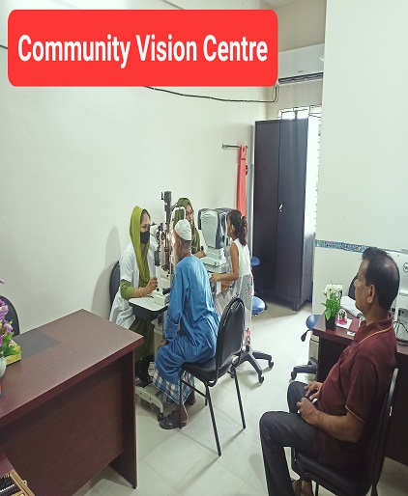
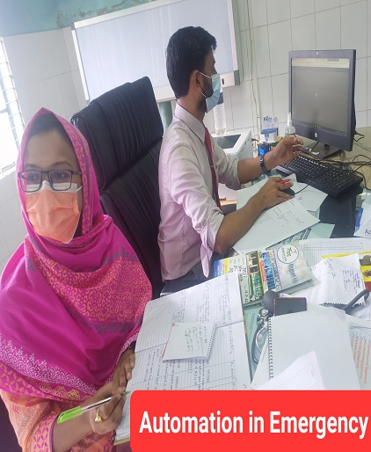
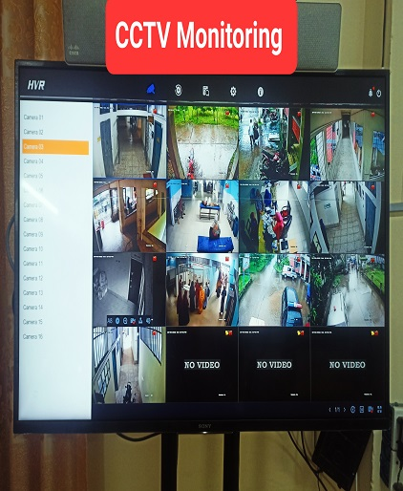
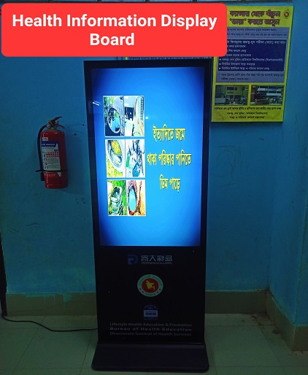
Activities of the health complex

Slide 11
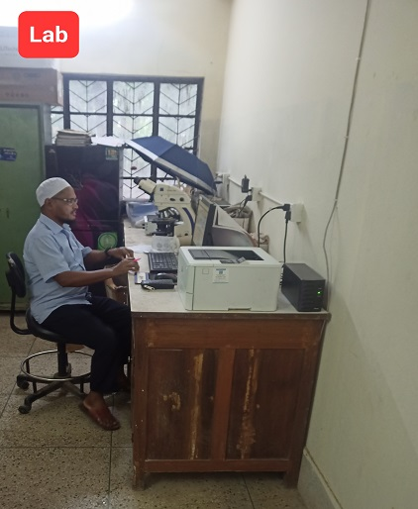
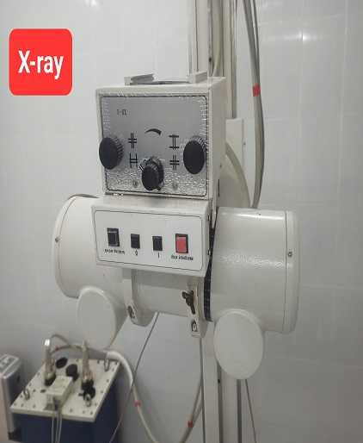
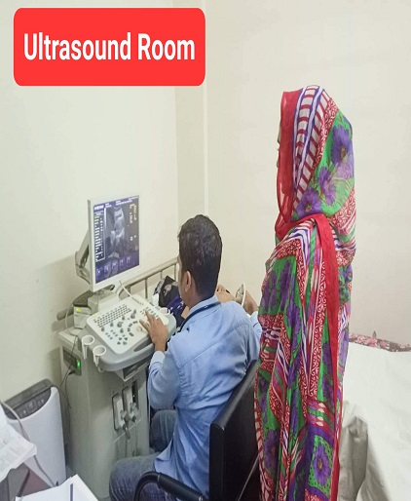
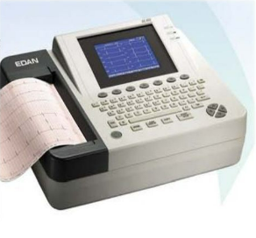
Diagnostic Activities of the health complex
Functioning ECG

Slide 12
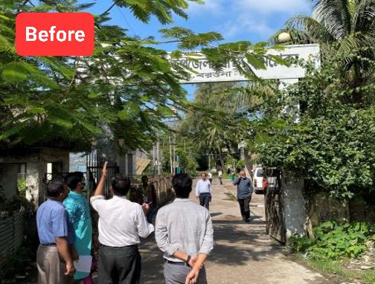
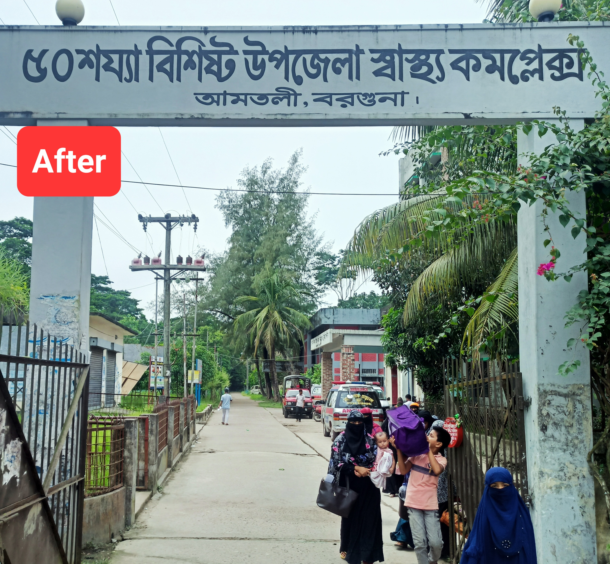
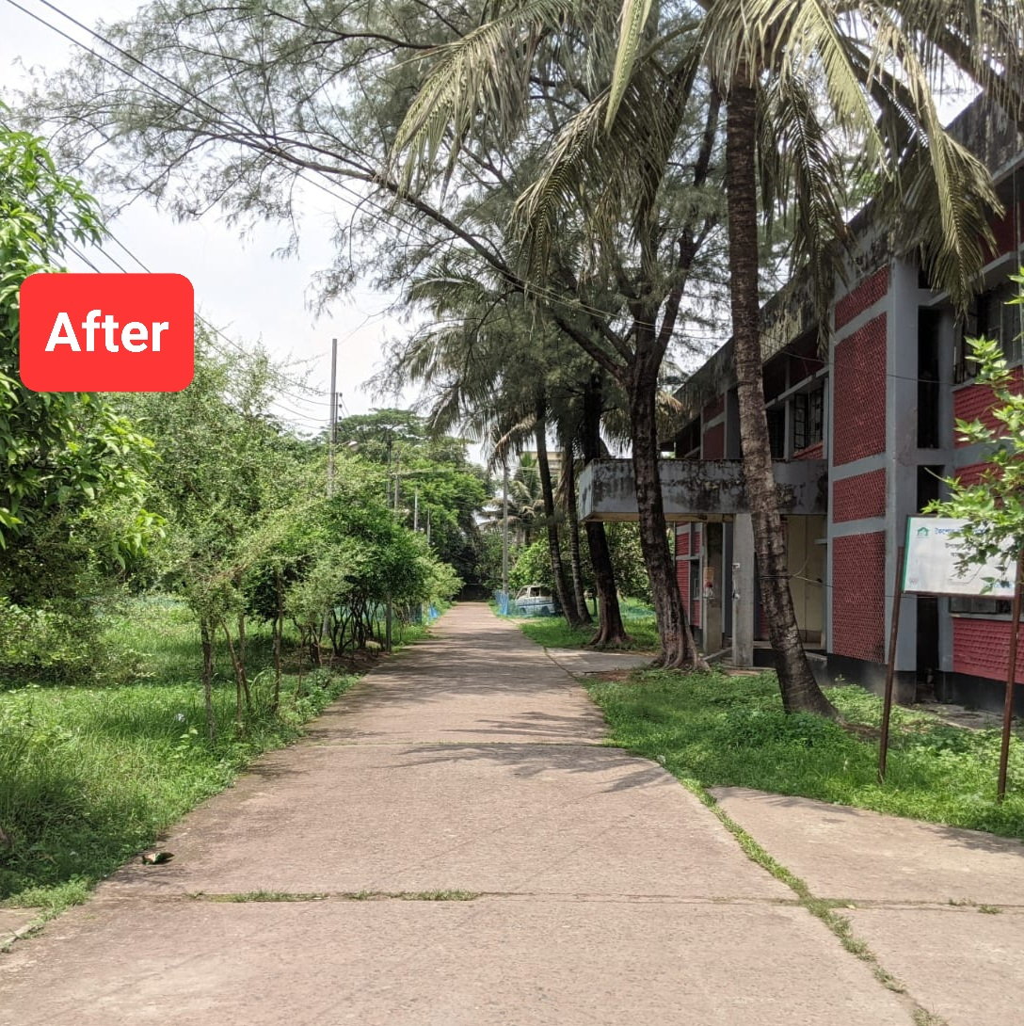
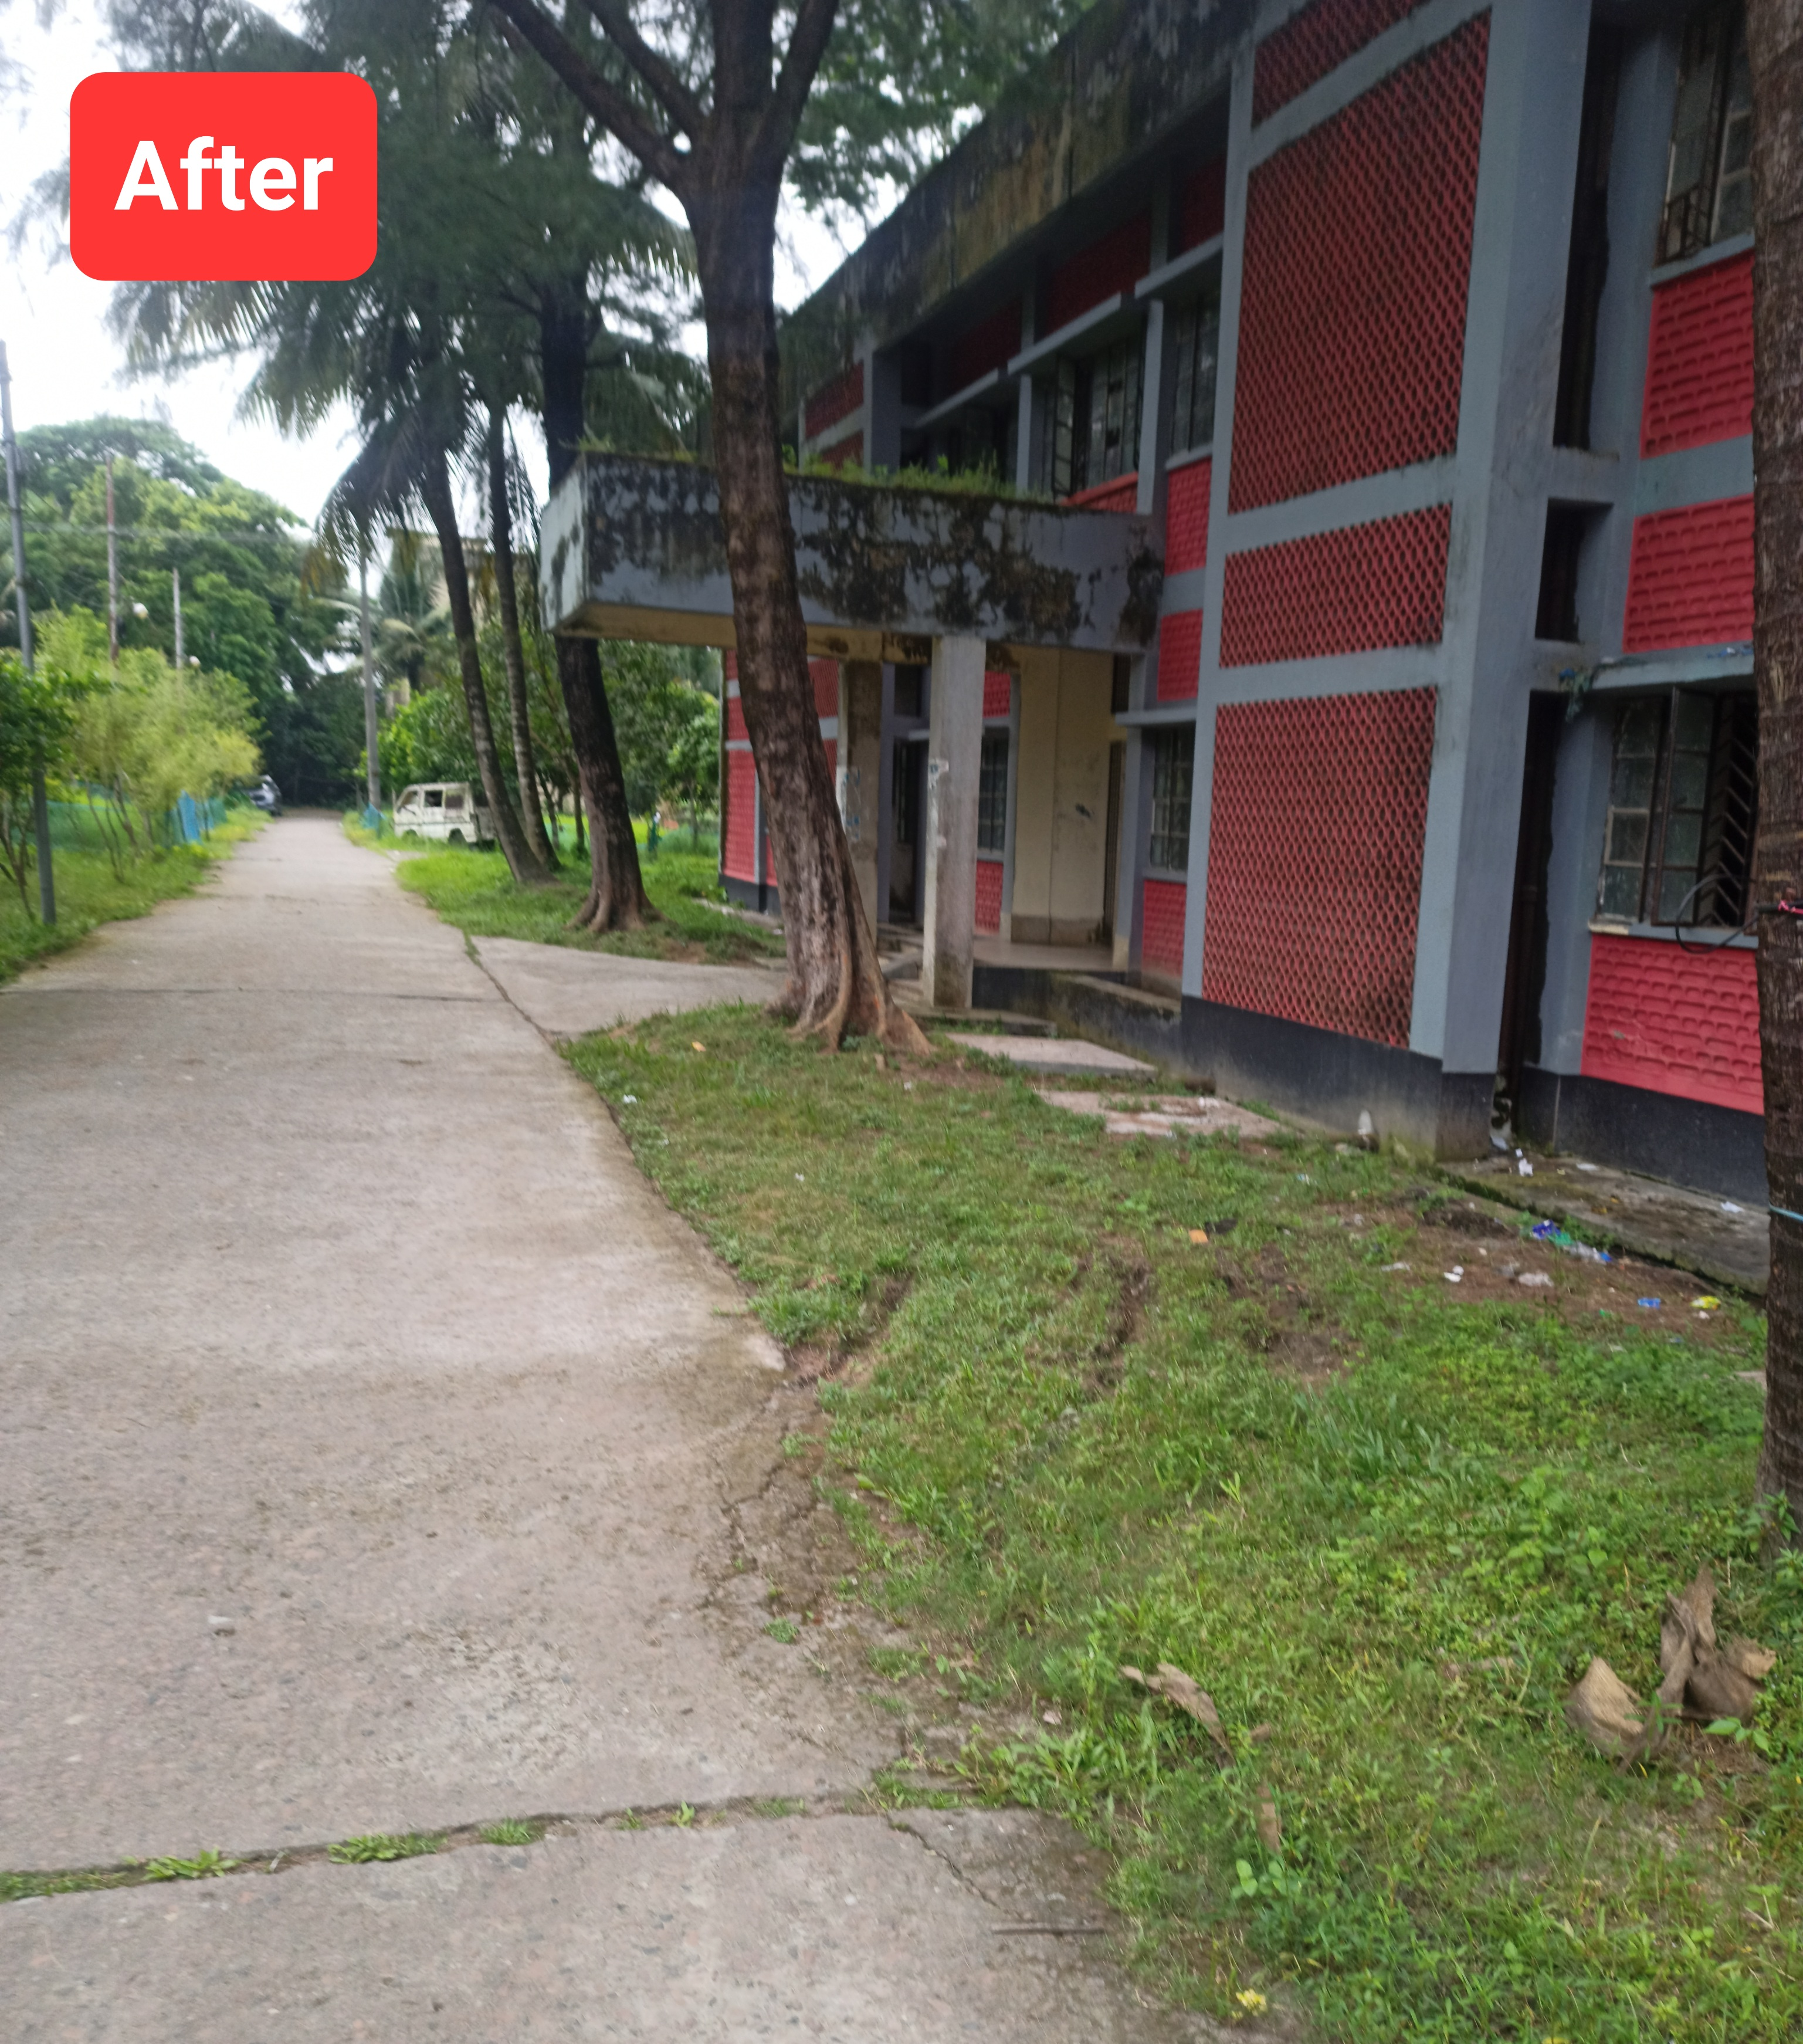
Changes in Compound of the UHC (Within Aug’22 to Sept’22)
Before

Slide 13
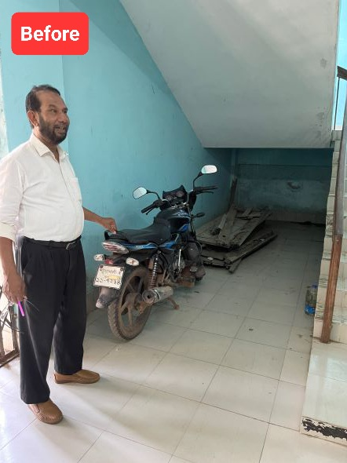
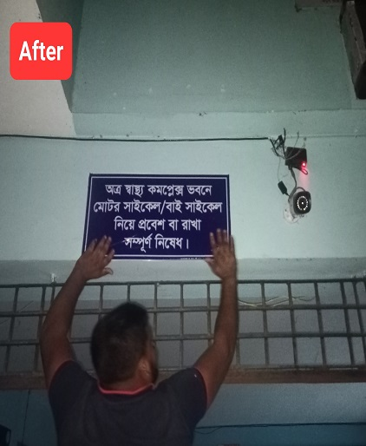
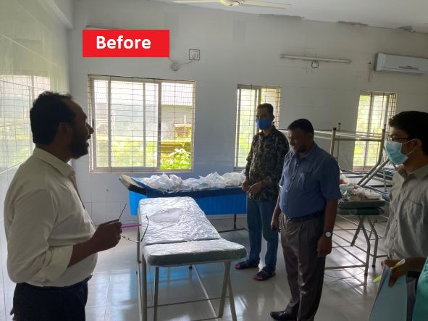
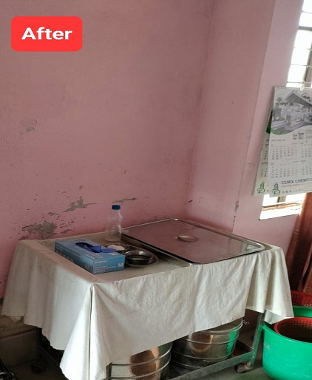
Changes in Emergency OT and Corridor (Within Aug’22 to Sept’22)

Slide 14
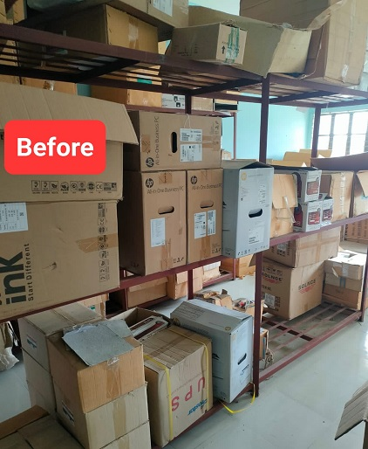
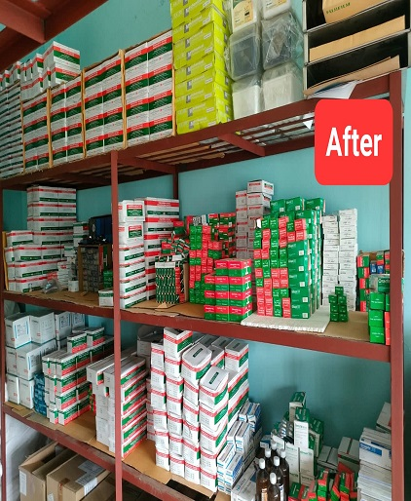
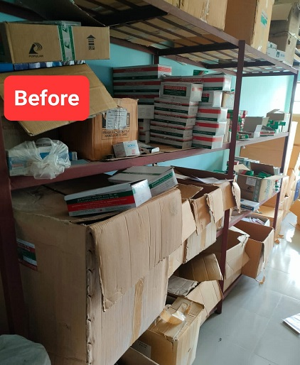
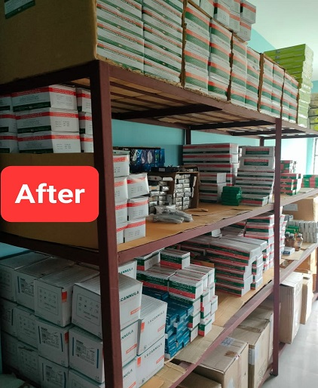

Changes in Store Room (Within Aug’22 to Sept’22)

Slide 15
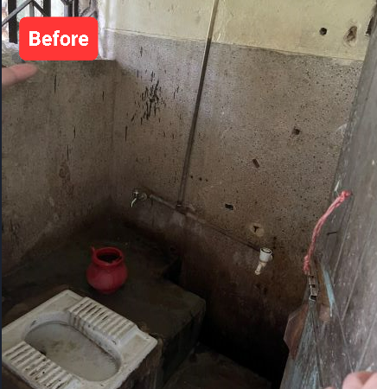
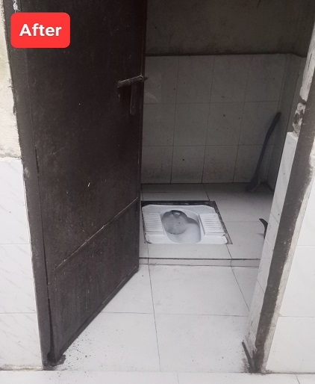
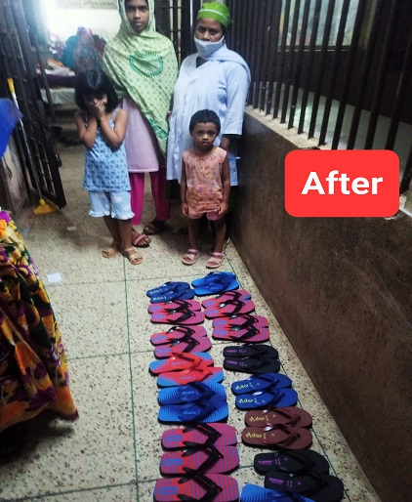
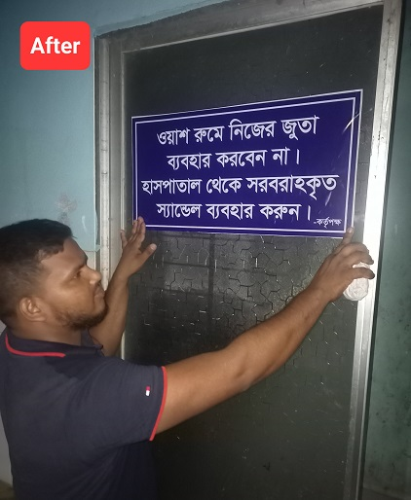
Changes in Ward (Within Aug’22 to Sept’22)

Slide 16
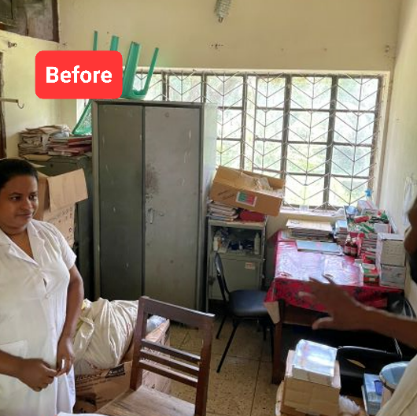
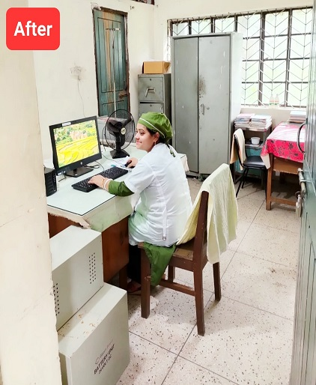
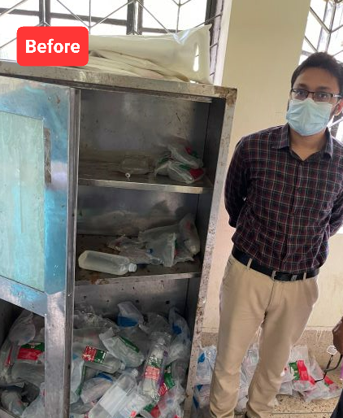
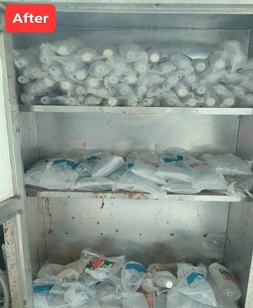
Changes in Nursing Station (Within Aug’22 to Sept’22)

Slide 17
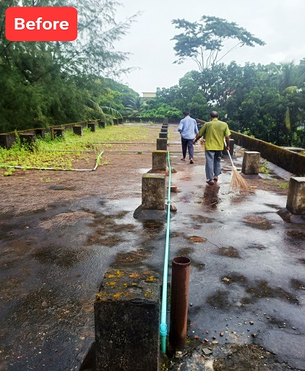
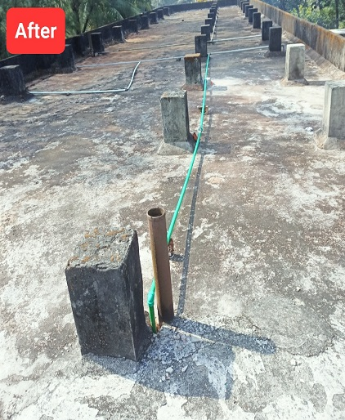
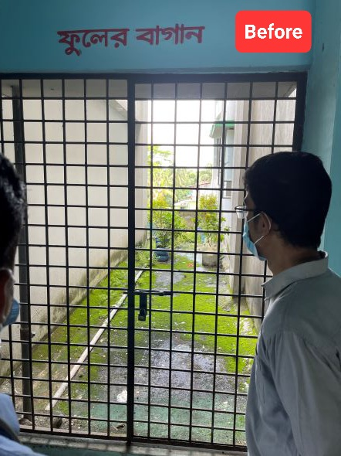
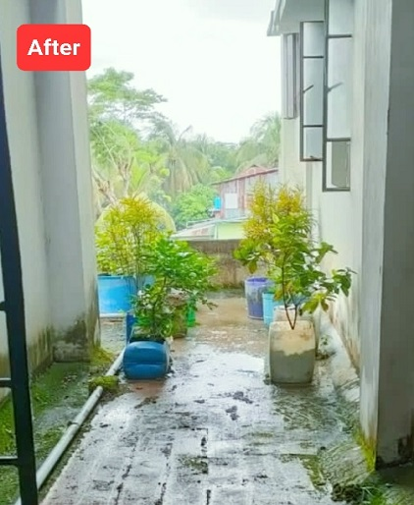
Changes on rooftop of the UHC (Within Aug’22 to Sept’22)

Slide 18
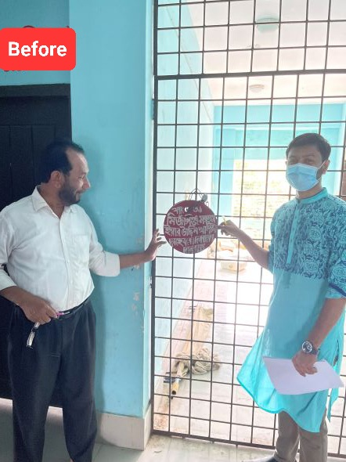
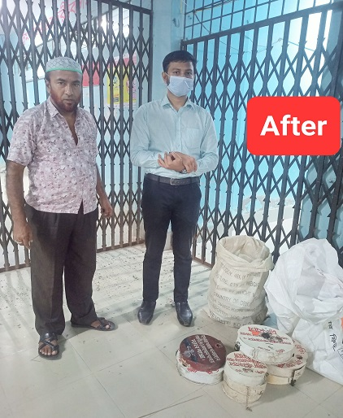
Removal of Danbox (Within Aug’22 to Sept’22)

Slide 19
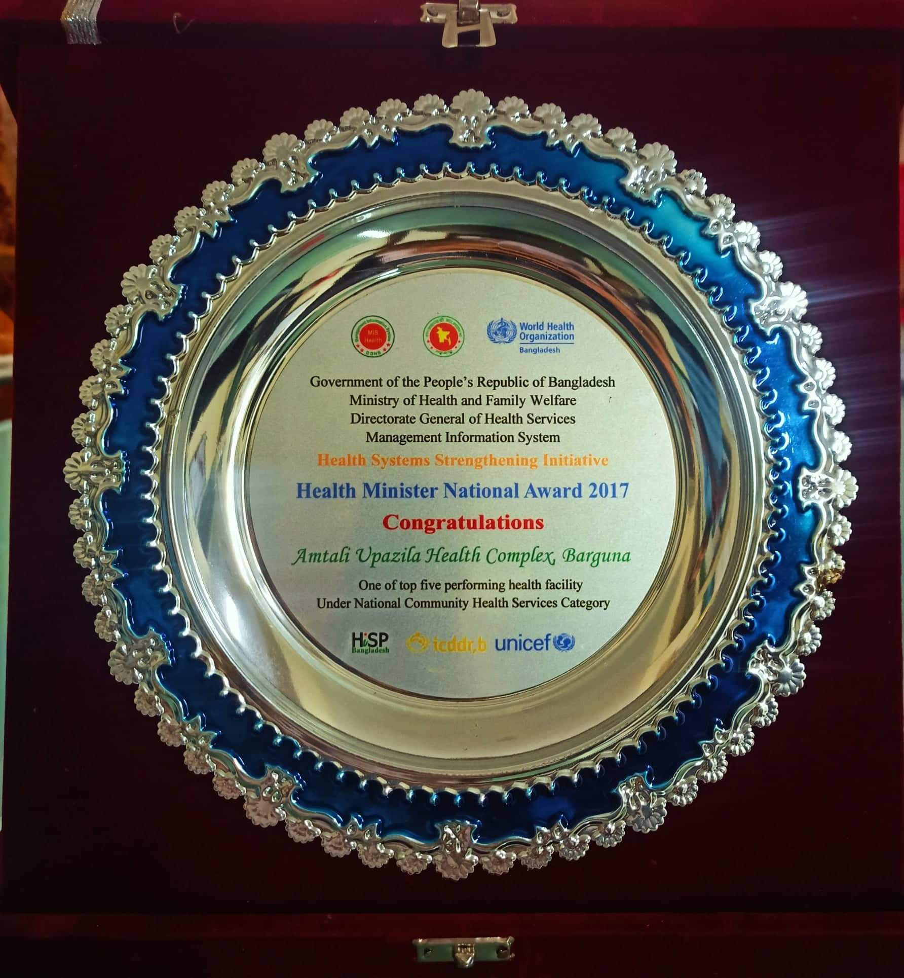
Upazila Health Complex
Amtali , Barguna.
Achievement of Amtali Upazila Health Complex
Amtali Upazila Health complex is awarded Health Minister National Award in 2017.
Trauma Center in the health complex.
Effective Community Vision Center.
Effective diagnostic system.
Automation Services in emergency, outdoor and indoor.

Slide 20
Upazila Health Complex
Amtali , Barguna.
Challenges of the health complex
C-Section and other major surgery not performed in the health complex.
Birth Death recording system is weak.
Many post of consultants are vacant.
Community participation is minimum.

Slide 21
Upazila Health Complex
Amtali , Barguna.
Way Forward
C-section should be started immediately.
Should be upgraded to 100 bedded hospital.
Increase community participation.
Establishment of blood bank.
Effective implementation of SSK program.

Slide 22


